Slide 1

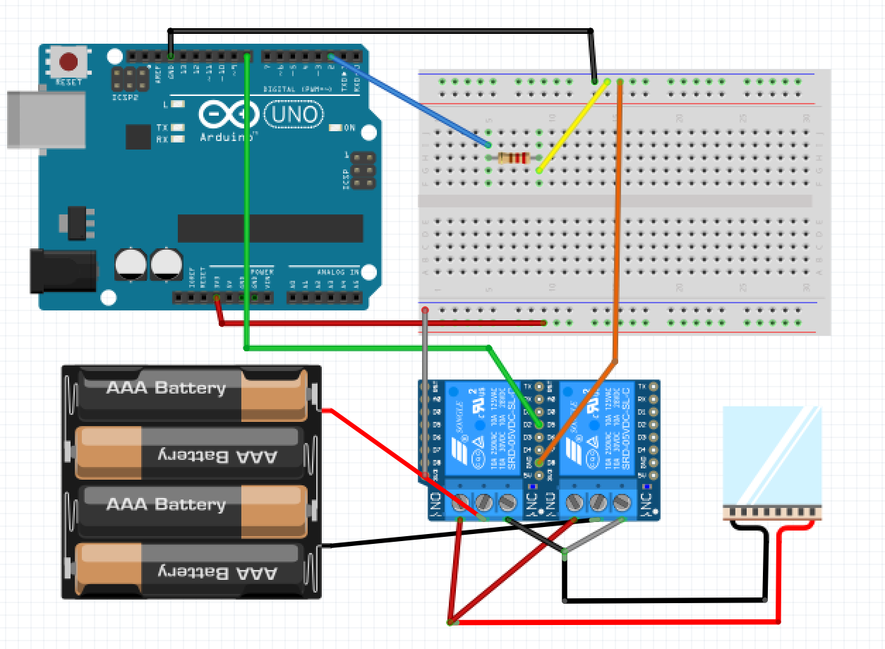
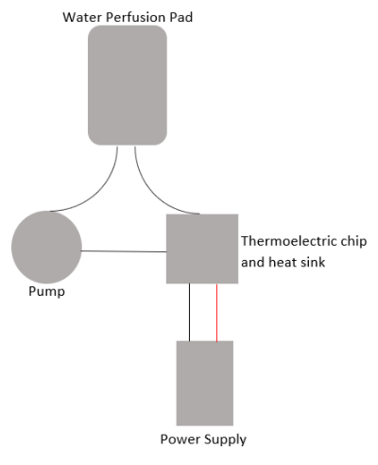



Contrast Therapy Wrap
Victoria Milosek, Christian Schonohoeft, Mira Roosth, Dalia Khater, Mayna Nguyen
Introduction
Circuit Schematic
Results
Conclusion
Localized cooling is commonly used to reduce bleeding, inflammation, metabolism, muscle spasm, pain, and swelling following soft tissue trauma. Localized heating is used to bring nutrient-rich blood to a treatment site. Contrast therapy is the combination of the vasoconstriction and vasodilation of cooling and heating an injury site.
A new device that independently provides contrast therapy can be used to optimize healing to an injury site.
Thermo-electric chip
Uses Peltier effect
Heats one side of chip, cools other side
Water Pump and Perfusion Pad
Pumps and circulates water that is heated/cooled system
Pad placed on skin throughout apply resulting contrast therapy
12V Power Supply
Powers the pump
Powers fan on chip’s heat sink
Powers the chip to provide voltage difference and Peltier effect
Arduino
Interfaces chip with relay modules to control heating/cooling
Reads and displays temperature with sensor
Accomplishes heating and cooling in one device
At $100, the device is relatively cheap compared to other contrast therapy devices at $2000+
Requires minimum change of parts (microwaving to obtain heat, or getting ice to cool)
Potential to be portable, only non-portable component is 12V power source.
Development Costs
Design Schematic
Future improvements
Materials and Costs
Arduino | $20
CPU Water Block | $19.98
AC to DC Power Supply | $15
Water Pump | $12.98
Relay Module | $7.99
Miscellaneous | $25.15
Total | $101.10
The device could be improved by making it portable as well as controlling the temperature more accurately.
Acknowledgements and References
Thanks to our mentors, Dr. Puperi and Dr. Diller
http://portalbiocursos.com.br/ohs/data/docs/56/56-_Alternating_hot_and_cold_water_immersion_for_athlete_recovery_a_review.pdf
https://www.ncbi.nlm.nih.gov/pmc/articles/PMC2938508/
http://www.humankinetics.com/excerpts/excerpts/how-to-use-heat-and-cold-to-treat-athletic-injuries
https://www.marlow.com/how-do-thermoelectric-coolers-tecs-work
Life Cycle of the Device
Heating for 10 Minutes
Device is Turned on
Cooling for 10 Minutes
Device is Turned off

Slide 2
Began by assembling the thermoelectric chip to the water block
Added the pump to the power supply
Connected the Arduino and the relay board to add efficiency

Slide 3
Thermoelectric chip
Uses Peltier effect
Heats one side of chip, cools other side
Water Pump and Perfusion Pad
Pumps and circulates water that is heated/cooled system
Pad placed on skin throughout apply resulting contrast therapy
12V Power Supply
Powers the pump
Powers fan on chip’s heat sink
Powers the chip to provide voltage difference and Peltier effect

